Slide 1
How do we evaluate place-based programs? Five questions to consider.
Brett Theodos
American Evaluation Association
October 17, 2013

Slide 2
Motivation
Place-based initiatives have dual aims to benefit people and neighborhoods
Considerable policy/funder energy: Choice Neighborhoods, Promise Neighborhoods, Strong Cities Strong Communities, multiple foundation-led comprehensive community change initiatives
Elements of theory (e.g. exposure, engagement and social processes) may falter, or at a minimum, make measurement difficult

Slide 3
Question 1
What is the right outcome?

Slide 4
Outcomes
Communities are extremely complex systems consisting of many interrelated structures and activities that, along with external factors, influence the very conditions a program seeks to affect
Individual program investments are often small in size relative to the neighborhoods or areas in which they take place

Slide 5
Outcomes
Programs frequently have broad mandates with respect to project activity types
Project location/initiation/purpose decisions frequently delegated to intermediaries
Program performance measurement must take into account this diversity so that projects can be evaluated against their intended purposes and desired outcomes

Slide 6
Outcomes
Picking the right outcome measures
The “poverty” fallacy
The double edge sword of jobs
Test scores
Is everything capitalized in home prices?

Slide 7
Question 2
What is the right unit of analysis?
People, housing units, neighborhoods or multiple?
If place, how do you define the target area/neighborhood

Slide 8
What is a neighborhood?
Providence

Slide 9
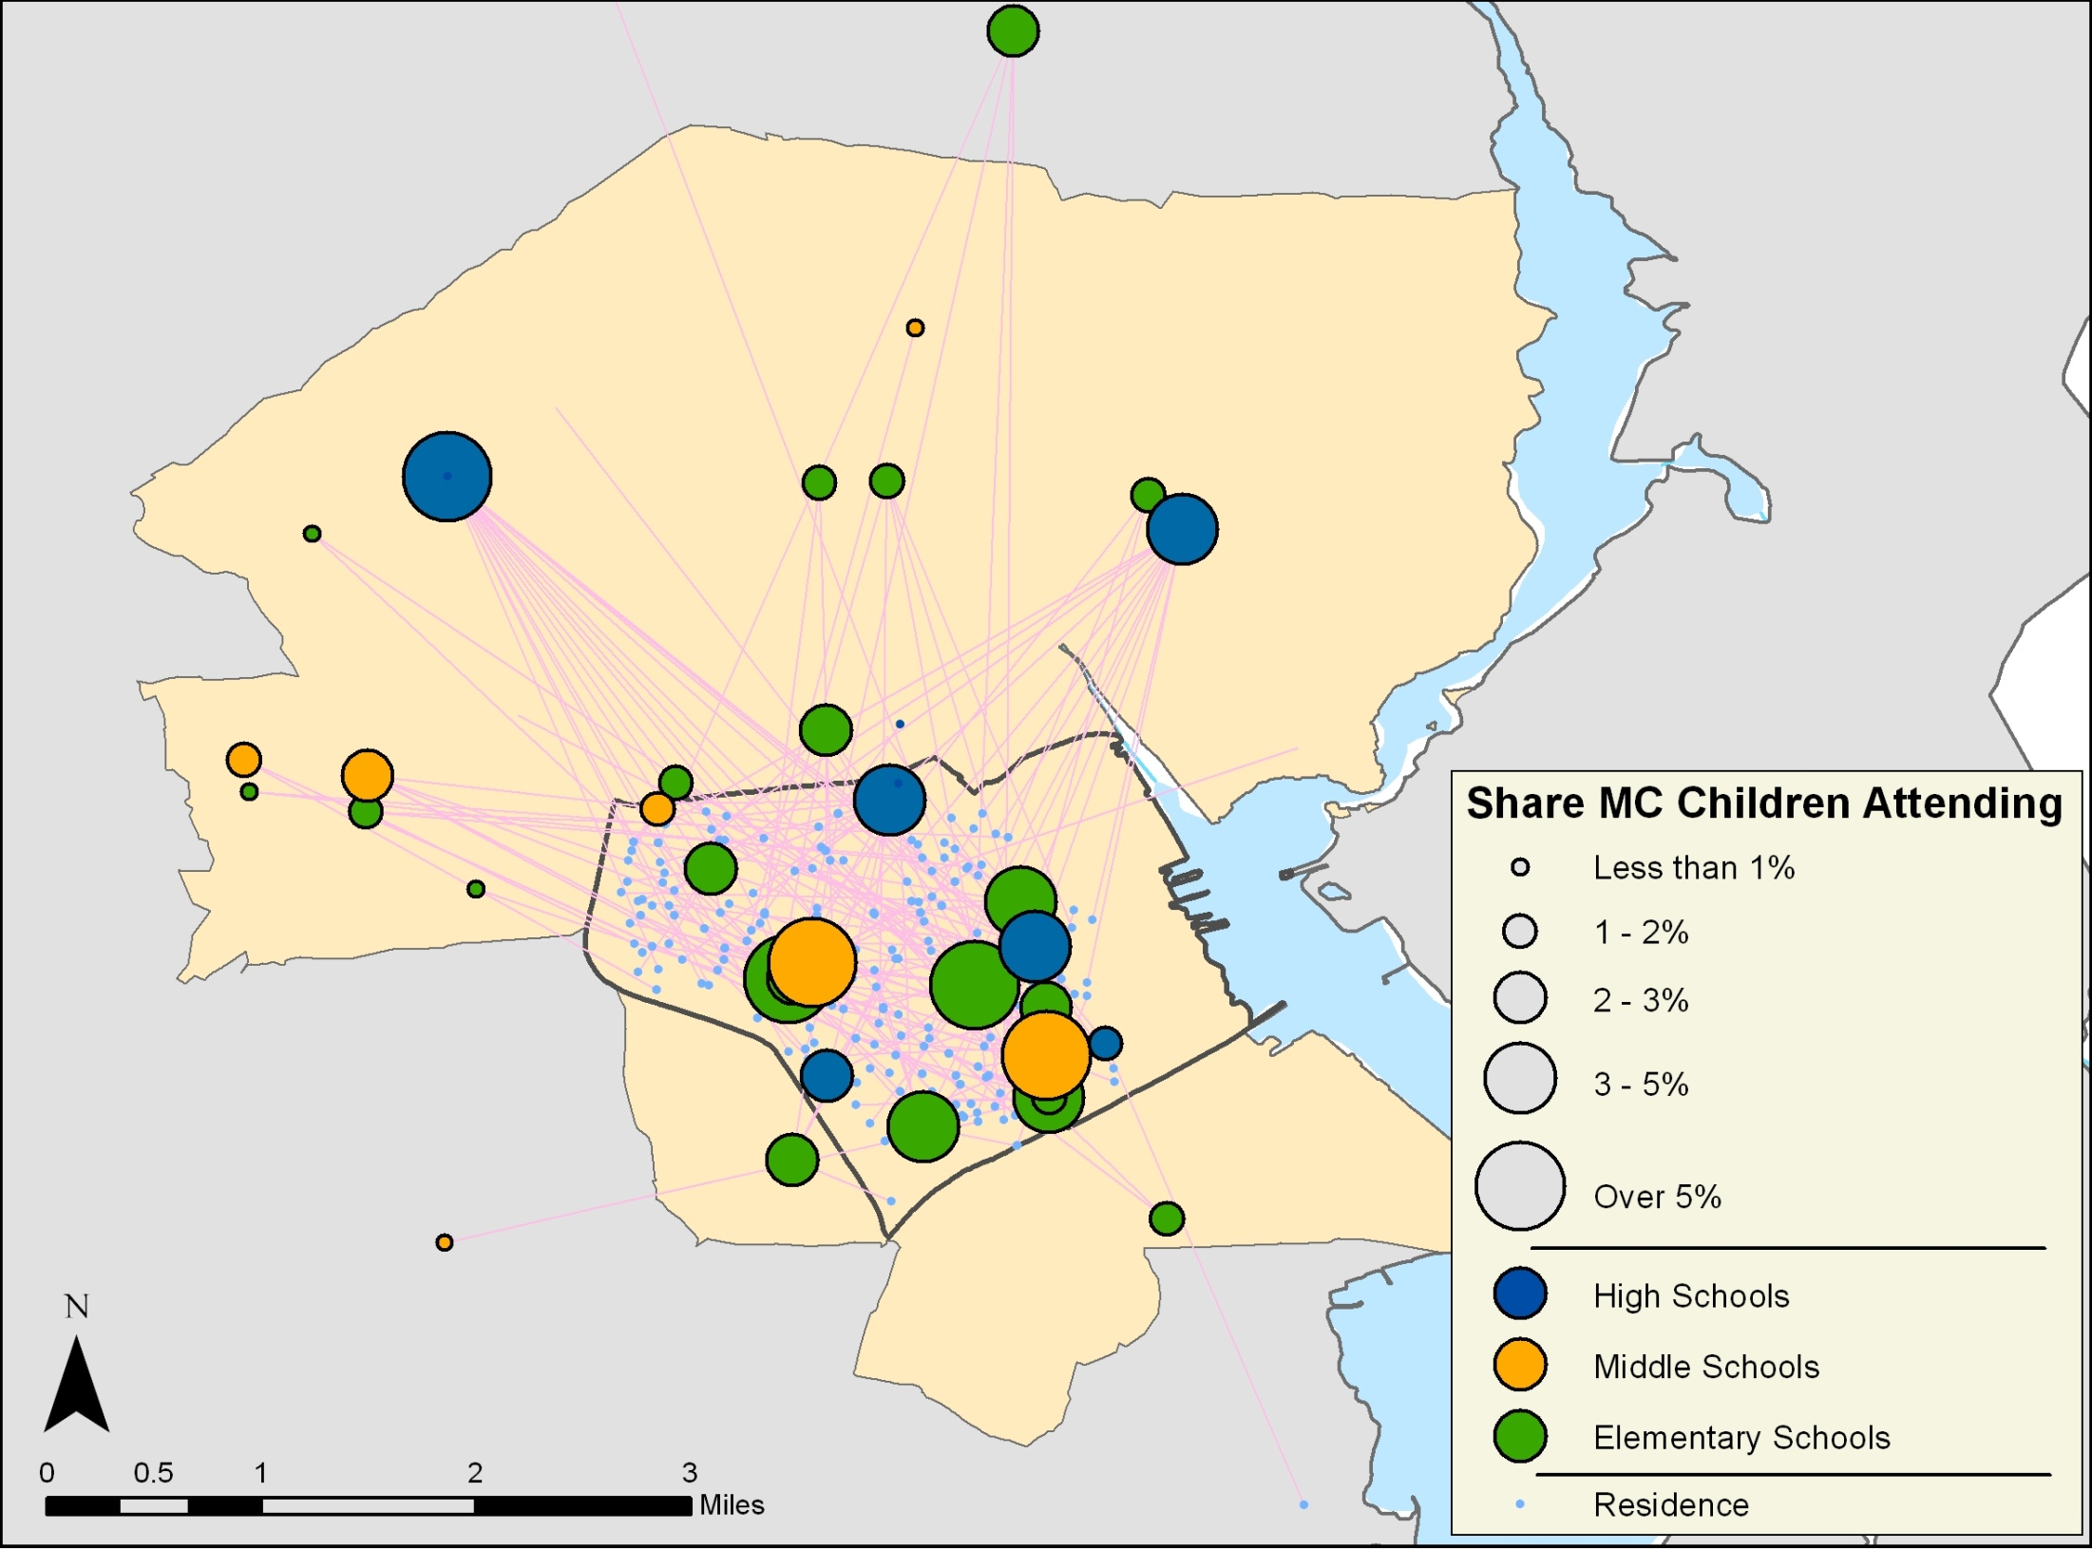
Providence Making Connections Site—Wave 1
280 Wave 1 Children

Slide 10
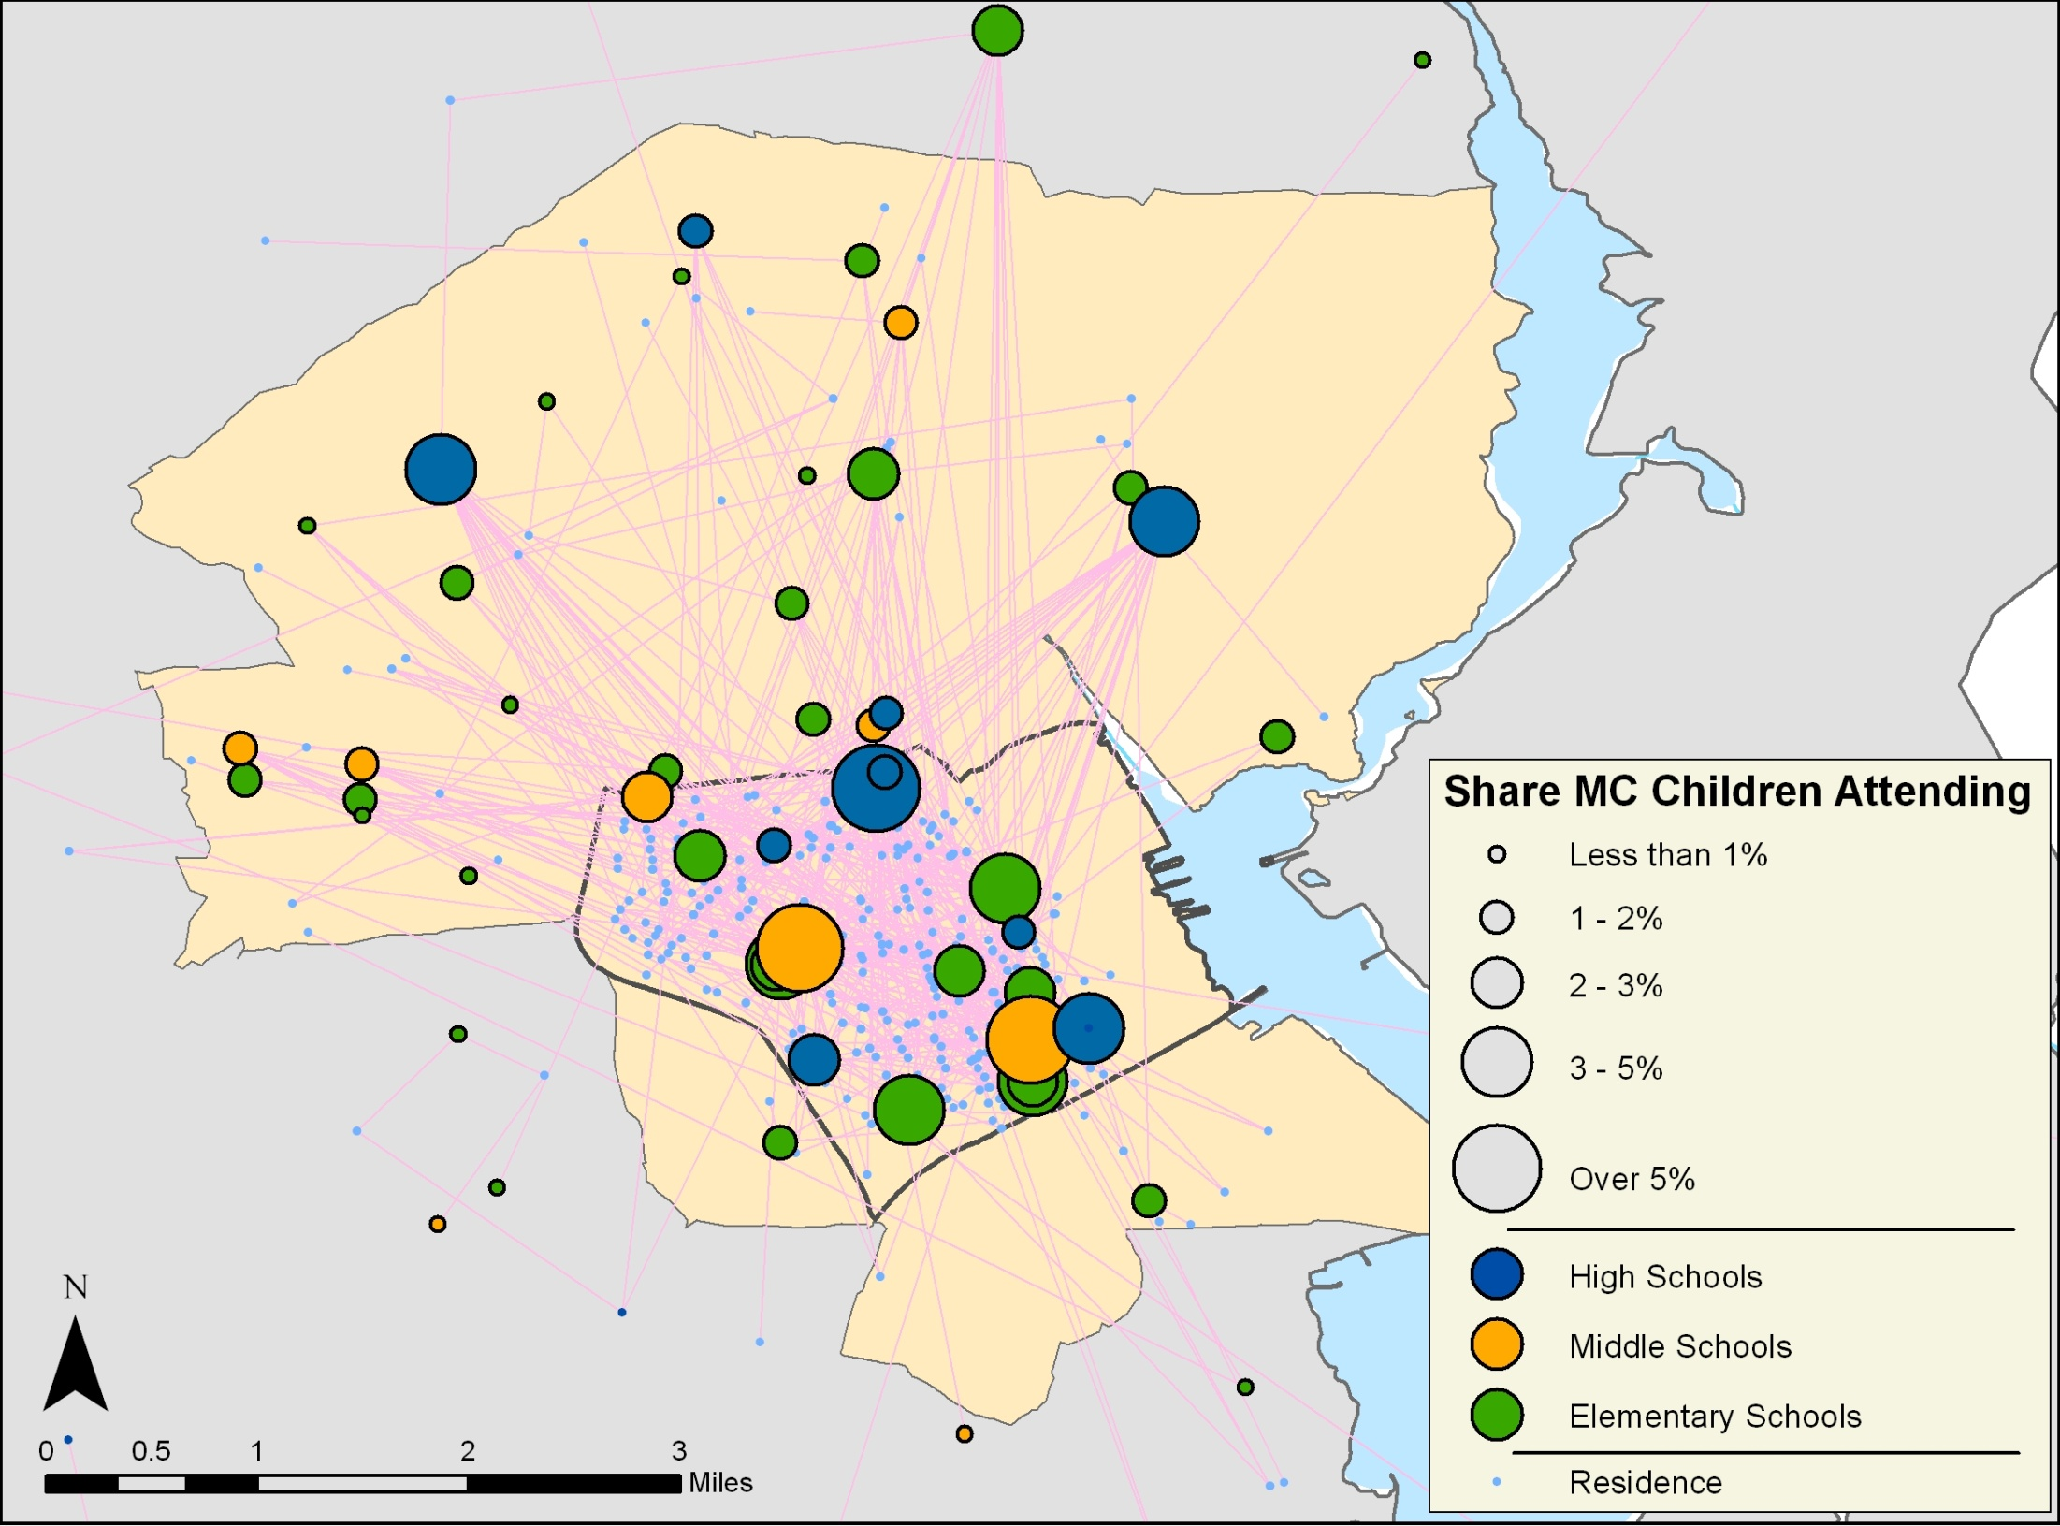
Providence Making Connections Site—Wave 2
671 Wave 2 Children

Slide 11
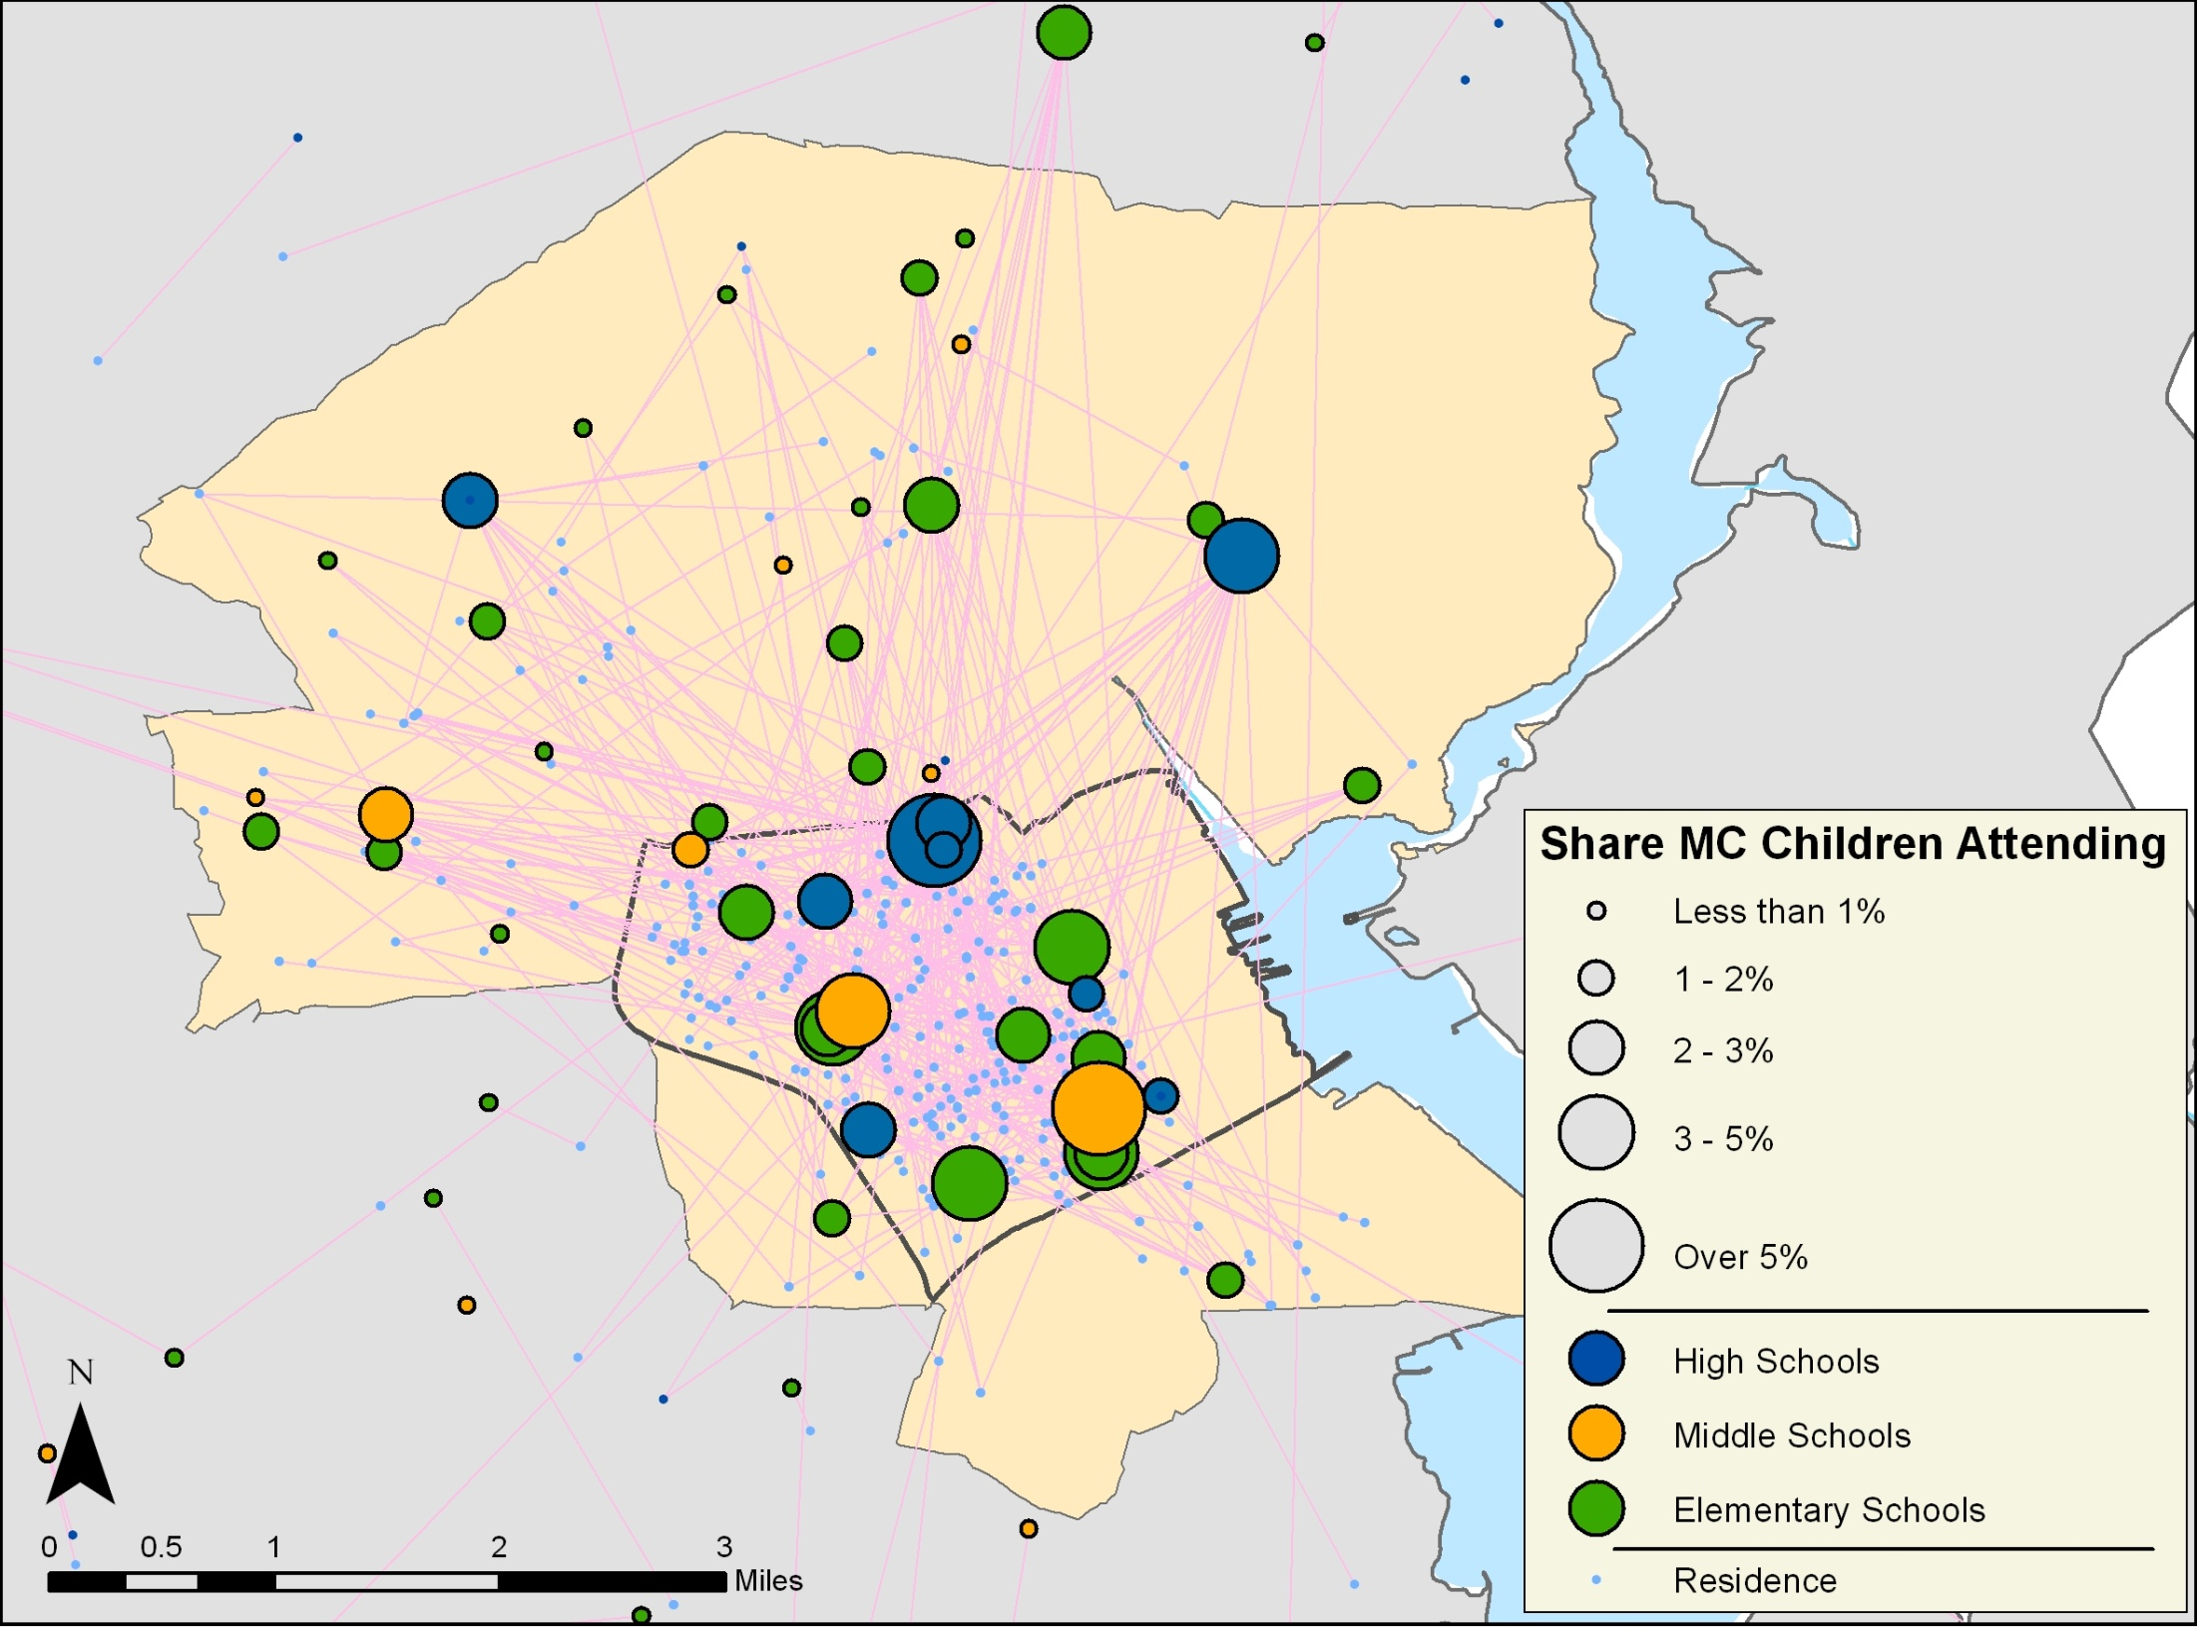
Providence Making Connections Site—Wave 3
666 Wave 3 Children

Slide 12
Question 3
How “stable” or mobile is the unit of analysis?

Slide 13
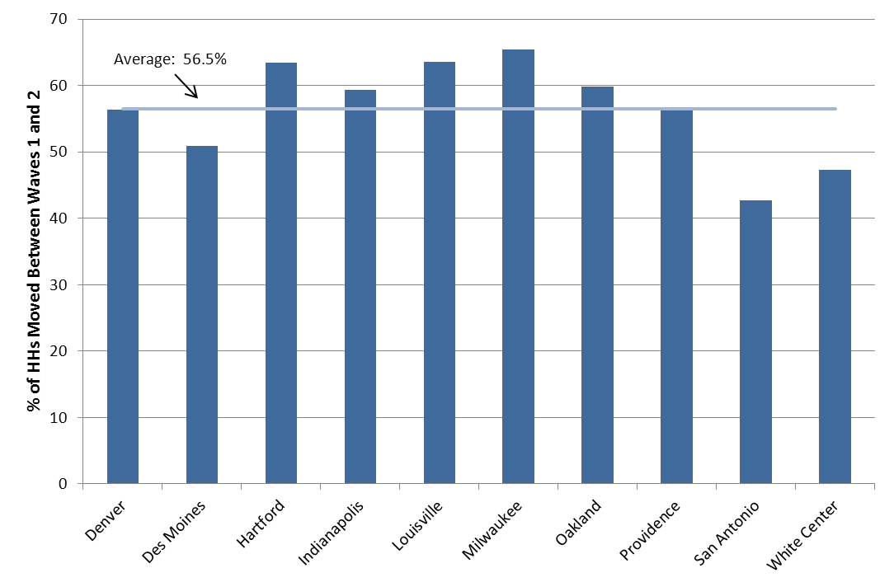
High Mobility Rates Over ~3 Years in Making Connections Neighborhoods

Slide 14
Components of Neighborhood Change: Conceptual Approach
Changing Circumstances for Stayers
Changes as Out-movers replaced by Newcomers
Wave 1
Wave 2
1
2
3
4
5
1
2
3
4
5
Wave 1
Wave 2
6
7
8
9
10
11
12
13
14
Non-poor
Poor

Slide 15
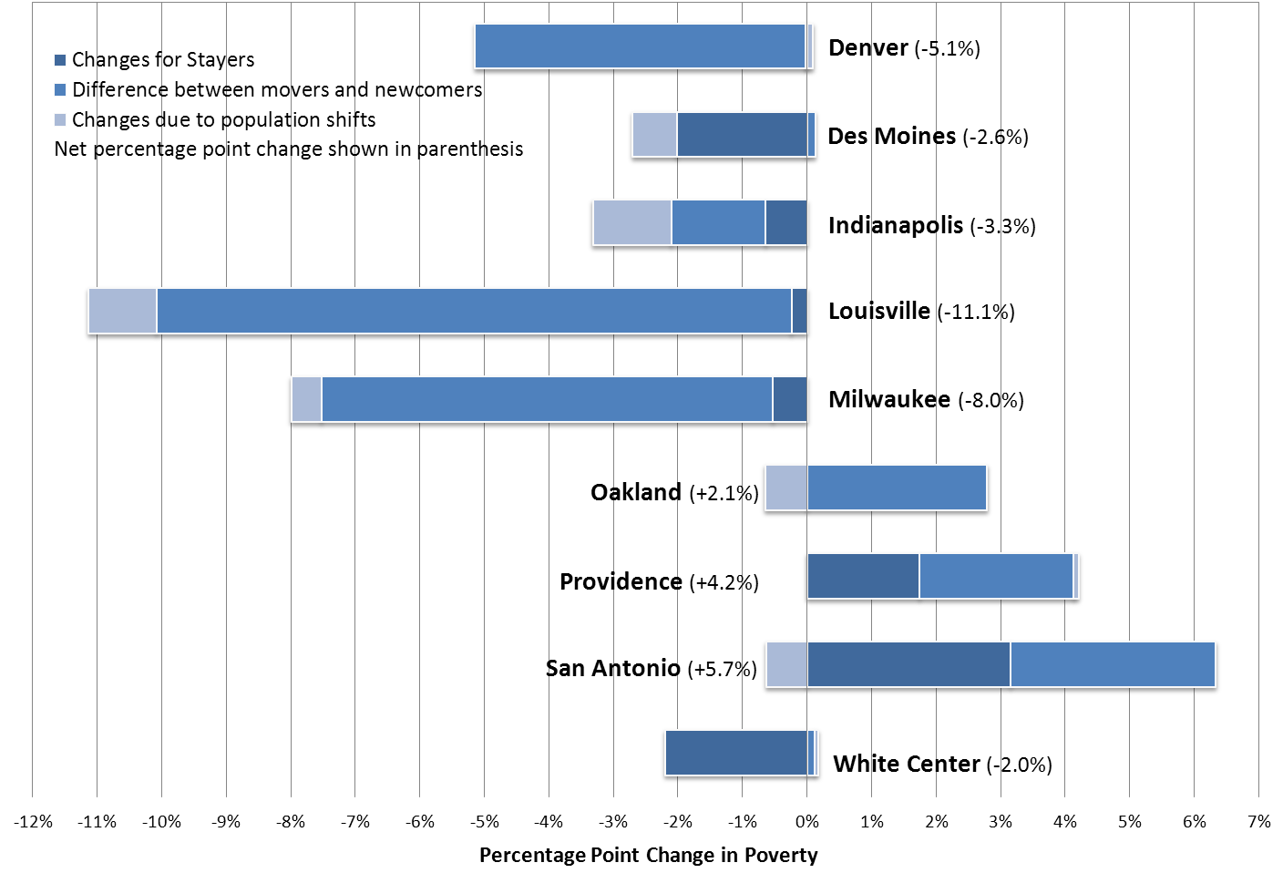
Components of Neighborhood Change in Making Connections Neighborhoods

Slide 16
Question 4
What is the right time period? How much exposure is necessary?

Slide 17
Time period & Exposure
Time period
Outcomes development can take time
Theory of change assumes duration of exposure
Example: HUD’s Moving To Opportunity demonstration

Slide 18
Question 5
What data and methods are available?
What standard of evidence is appropriate or sufficient?

Slide 19
Data
Case studies and qualitative data collection (e.g. New Markets Tax Credit, HUD’s Section 108)
Neighborhood surveys (cross sectional or panel, following out-movers or not) (e.g. Making Connections)
Local data, including Integrated data systems (IDSs) (e.g. data collected by National N’hood Indicators Partners
Publically available secondary data (e.g. American Community Survey, American Housing Survey, Home Mortgage Disclosure Act data)
Proprietary data (e.g. CoreLogic, credit bureaus)

Slide 20
Methods
Case studies and/or qualitative data analysis
Pre-post cross sectional
Adjusted interrupted time series (e.g. Community Development Block Grant, HOME program)
Regression discontinuity (e.g. Low Income Housing Tax Credit, Community Development Block Grant, New Markets Tax Credit)
Spatial hedonic (e.g. downpayment assistance)
Propensity score matching
Not likely: RCTs

Slide 21
Resources
Evaluating Economic and Community Development Programs (2010)
Residential Mobility and Neighborhood Change: Real Neighborhoods Under the Microscope (2012)
Platforms for Place-based Development in the U.S. (2012)
New Markets Tax Credit Program Evaluation (2013)
Getting to Better Performing Schools: The Role of Residential Mobility in School Attainment in Low-income Neighborhoods (2014)
Neighborhood Stability and Neighborhood Change: A Study of Housing Unit Turnover in Making Connections Neighborhoods (2012)

